Slide 1
Institute of seismology, National Academy of sciences, Kyrgyz Republic
Kyrgyz System
of Seismic Monitoring
• October 23-26, 2017, Baku, Azerbaijan •

Slide 2
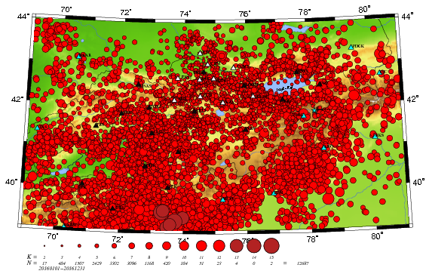
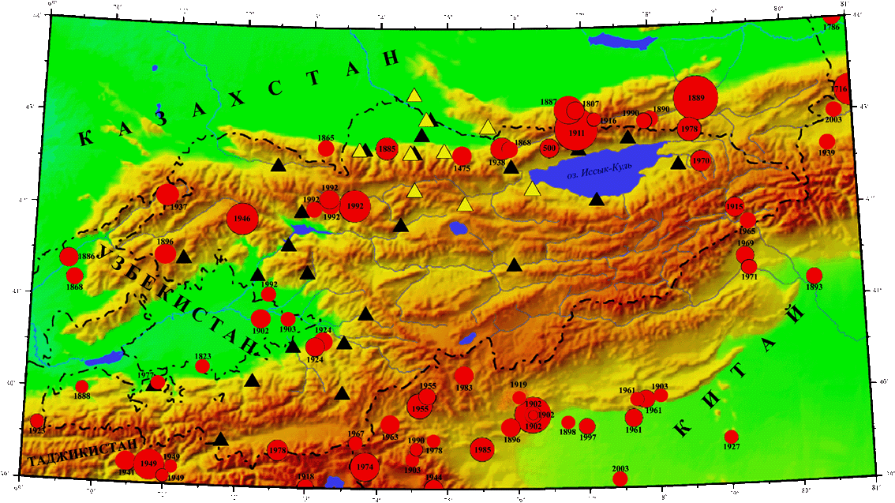
Institute of seismology, National Academy of sciences, Kyrgyz Republic
Seismic monitoring
Geographically Kyrgyzstan is located in the limits of the Tien-Shan orogen, the modern tectonic activity of which defines a high seismicity of this territory. Very strong earthquakes with magnitude up to 8 and a lot of weaker events occur here. In average we process more then 9000 earthquakes per year, occurred on our territory. That is why the problems of seismic monitoring and seismic hazard assessment are very actual for Kyrgyzstan.
Map of seismicity of Kyrgyz territory for 2016
(M ≥ 0, N=12687, from which 6 events with M ≥ 5.0)
Map of strongest earthquake distribution for all period of observation (M ≥ 6.5)

Slide 3
Institute of seismology, National Academy of sciences, Kyrgyz Republic
Developmental stages of Kyrgyz System of Seismic Monitoring
The instrumental seismic observations in Kyrgyzstan have begun since 1927 on the base of analogue stations that essentially influenced on the network efficiency.
In October, 1990 the first digital broad-band seismic station AAK has been installed on the Kyrgyz territory as an observation point of Global Seismographic Network IRIS/IDA. This seismic station is included into IMS CTBTO as a 3C auxiliary station AS060.
Since September, 1991 the telemetry network KNET consisting of 10 stations, equipped with broad-band high-sensitive devices has begun its operation here.
In 2007, within the frame of CTBT capacity building, NORSAR, with support from the Ministry of Foreign Affairs of Norway, provided the Kyrgyz Institute of Seismology with 10 digital broad-band stations, most of which have been installed in the south of Kyrgyzstan characterized by the high level of seismic activity.
In 2009 the new seismic network has been registered in FDSN as KRNET (Kyrgyz Republic Digital Network, KR). At present it consists of 17 broad-band stations located on all territory of Kyrgyzstan. Moreover under IRIS support the real time data of most part of KRNET stations are openly accessible at the IRIS–DMC website.
Nowadays the Kyrgyz system of seismic monitoring includes 10 KNET stations and 17 KRNET stations, otherwise 27 seismic stations.
Gb

Slide 4
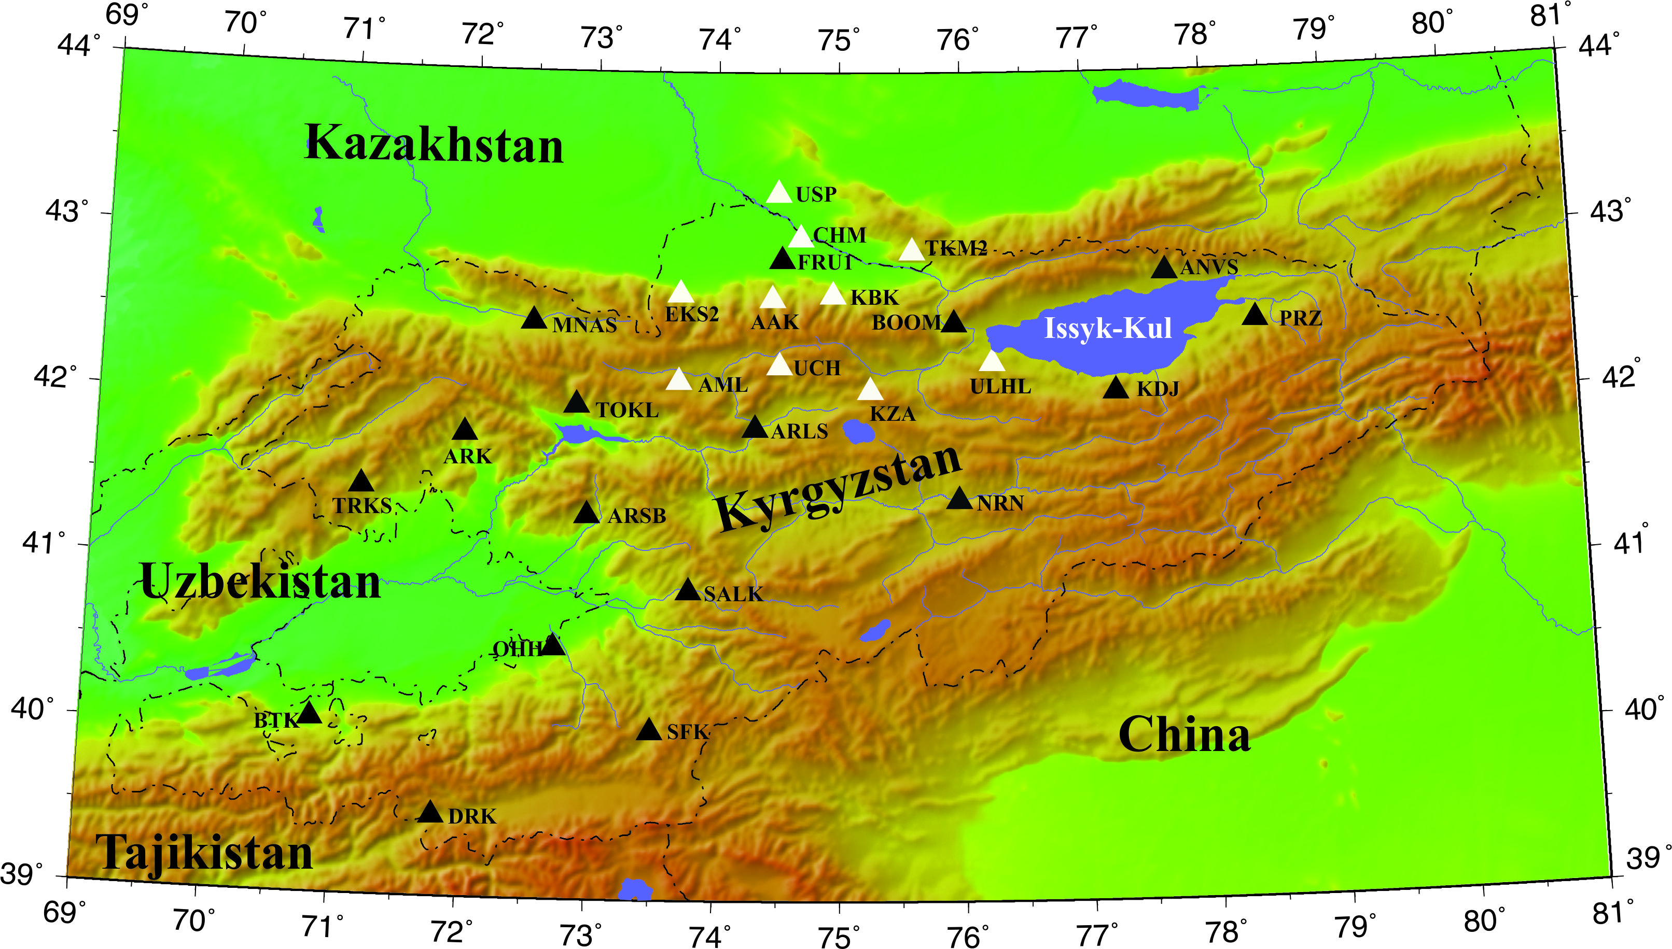
Institute of seismology, National Academy of sciences, Kyrgyz Republic
Kyrgyz system of seismic monitoring
- KNET stations
- KRNET stations (IS NAS KR)

Slide 5
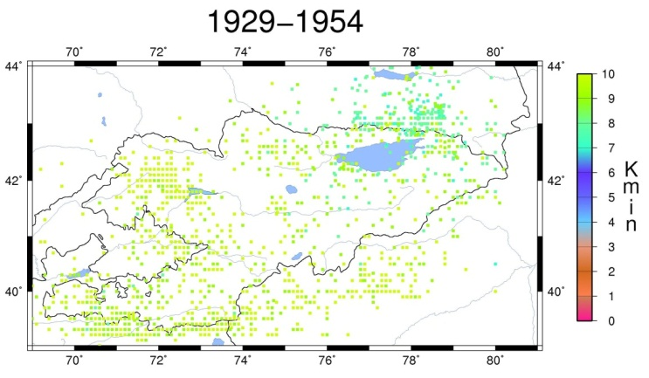
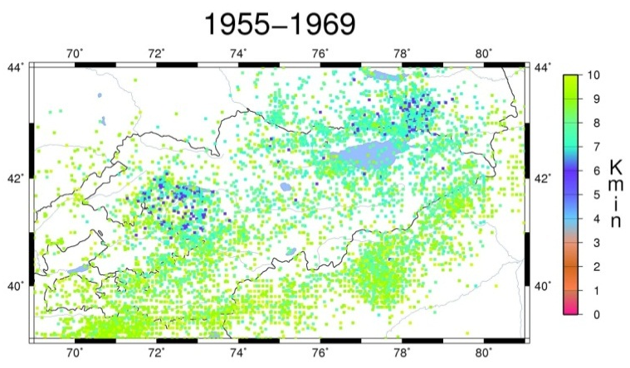
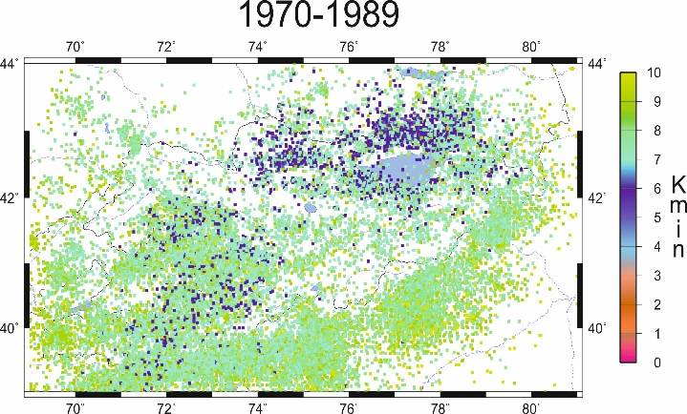
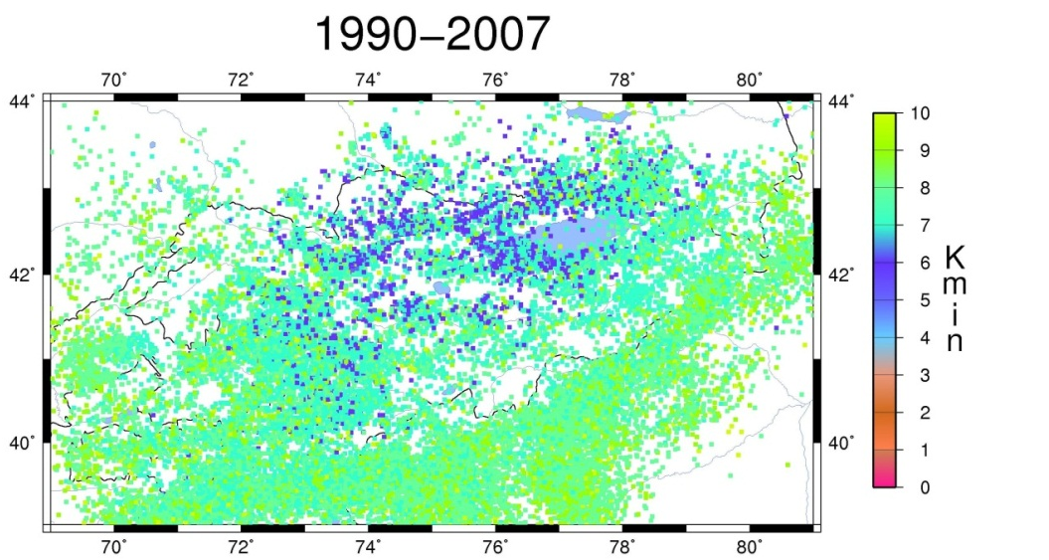
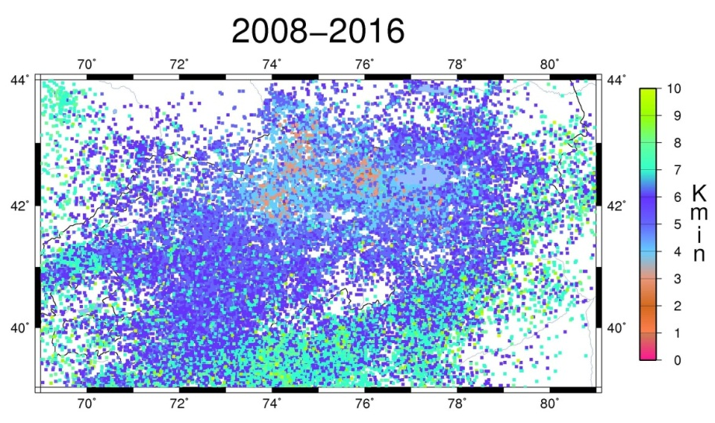
Institute of seismology, National Academy of sciences, Kyrgyz Republic
Examples of capability of Kyrgyz system of seismic monitoring
Mmin → ∀ [0.5° × 0.5° ]

Slide 6
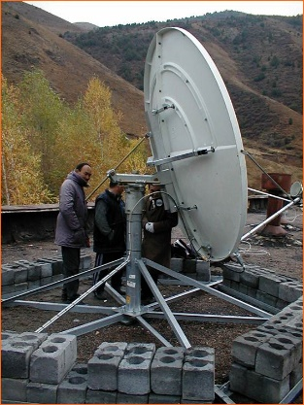
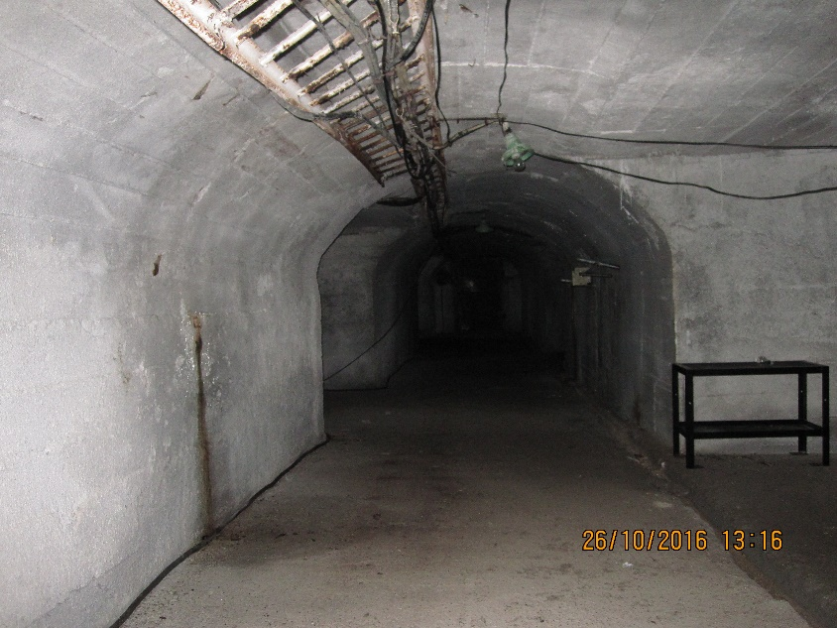
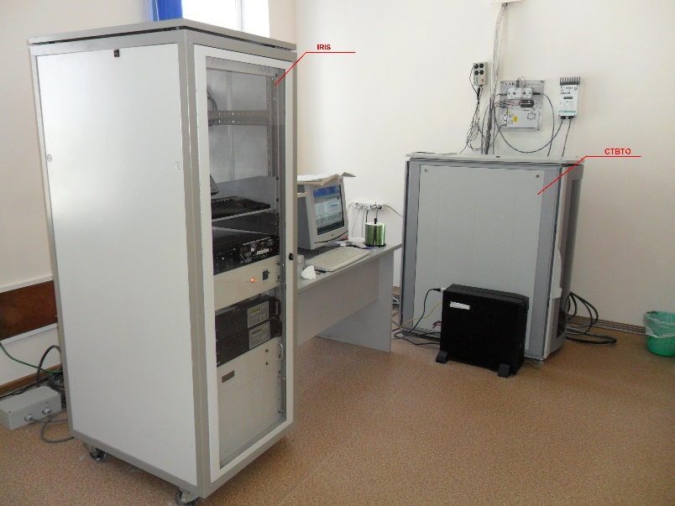
Institute of seismology, National Academy of sciences, Kyrgyz Republic
Example of IRIS/IDA (IMS CTBTO) seismic station AAK (AS060) in Kyrgyzstan

Slide 7
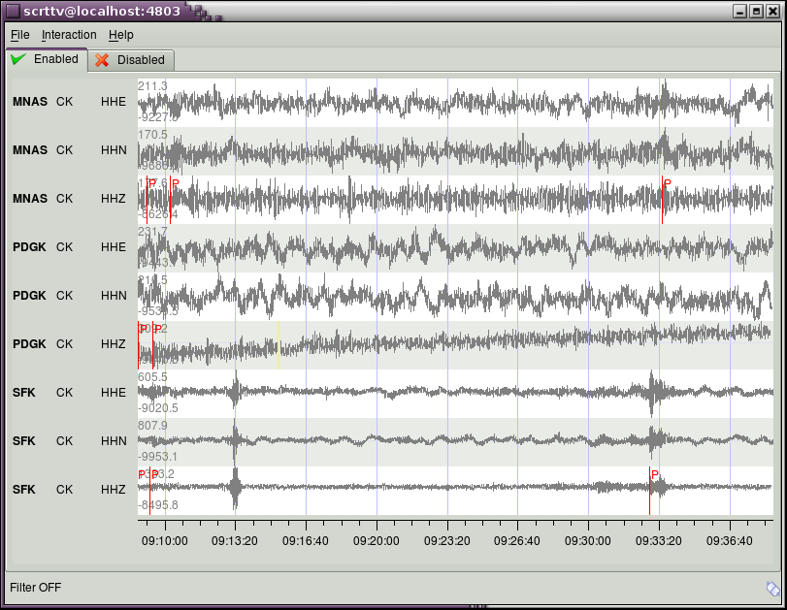
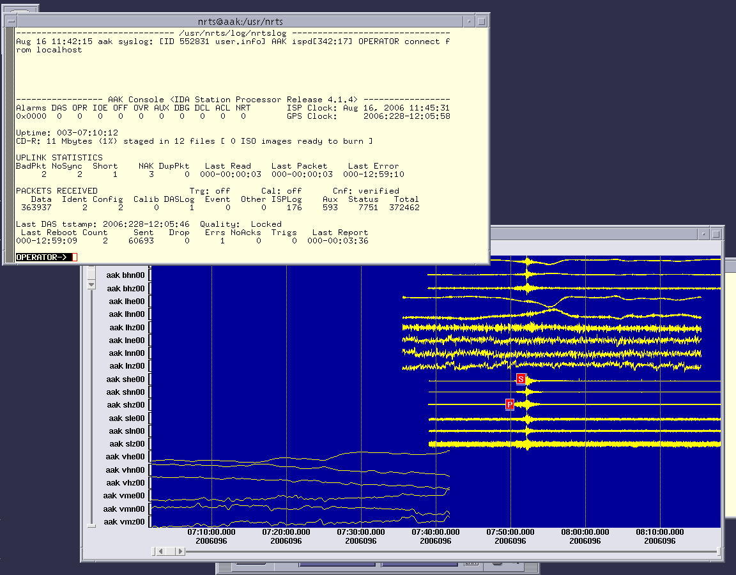
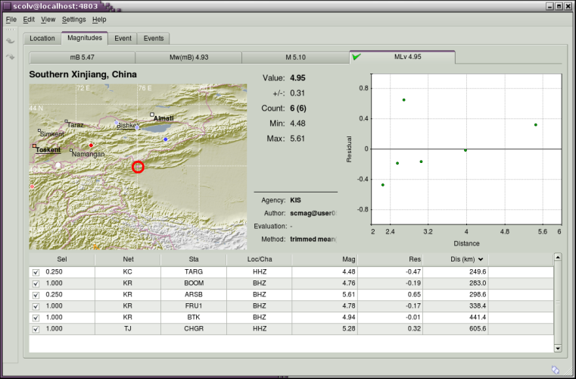
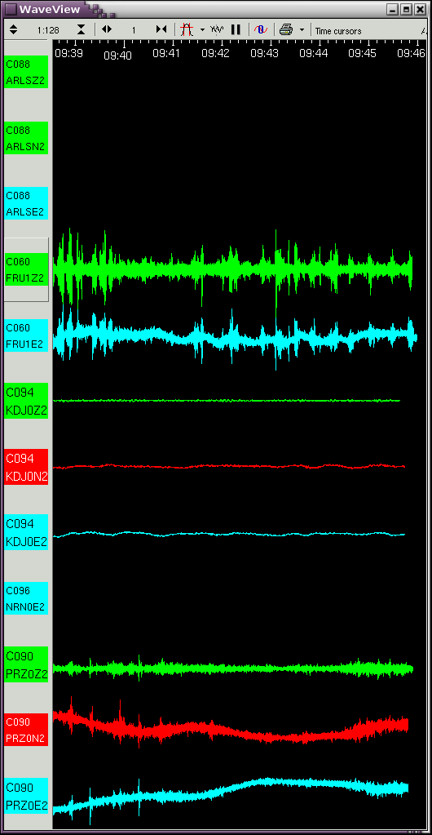
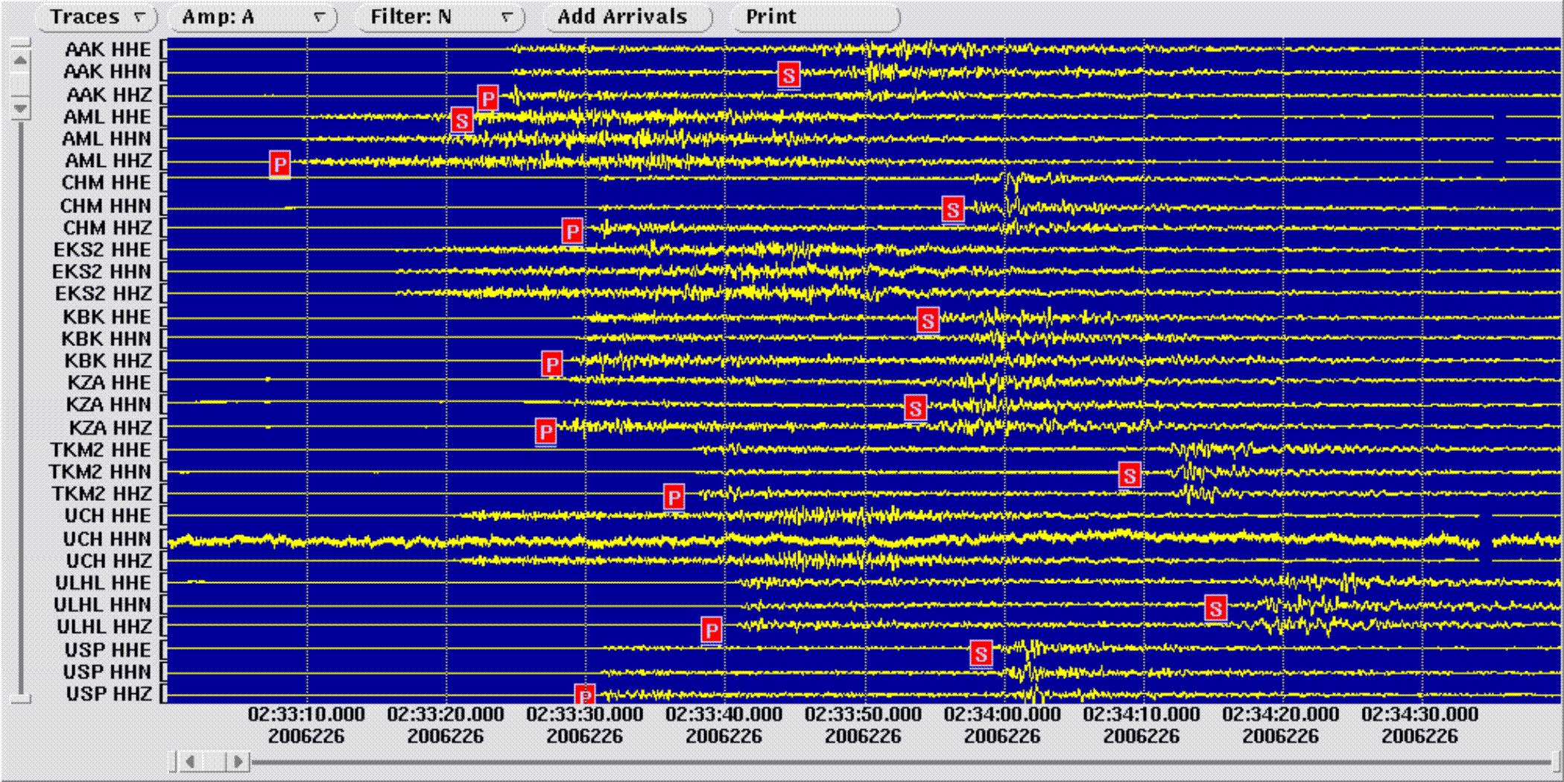
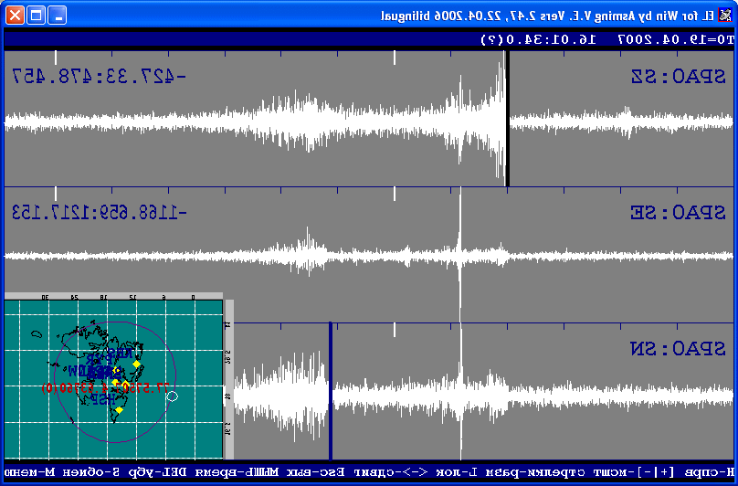
Institute of seismology, National Academy of sciences, Kyrgyz Republic
SeisComp3 (Seedlink)
Data transmission
Antelope (orb2orb)
Scream!

Slide 8
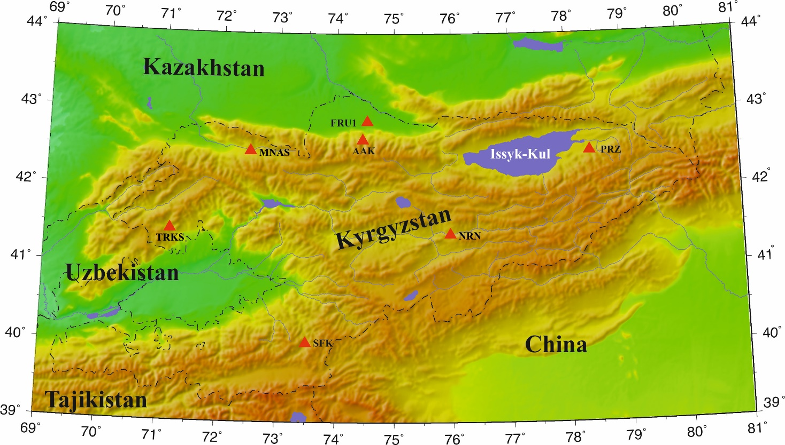
Institute of seismology, National Academy of sciences, Kyrgyz Republic
Strong motion monitoring
- Stations, equipped by the strong motion devices

Slide 9
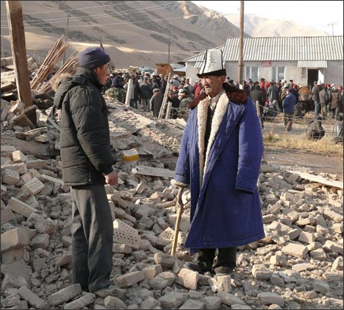
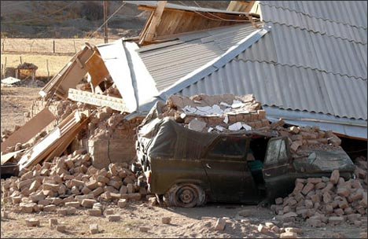
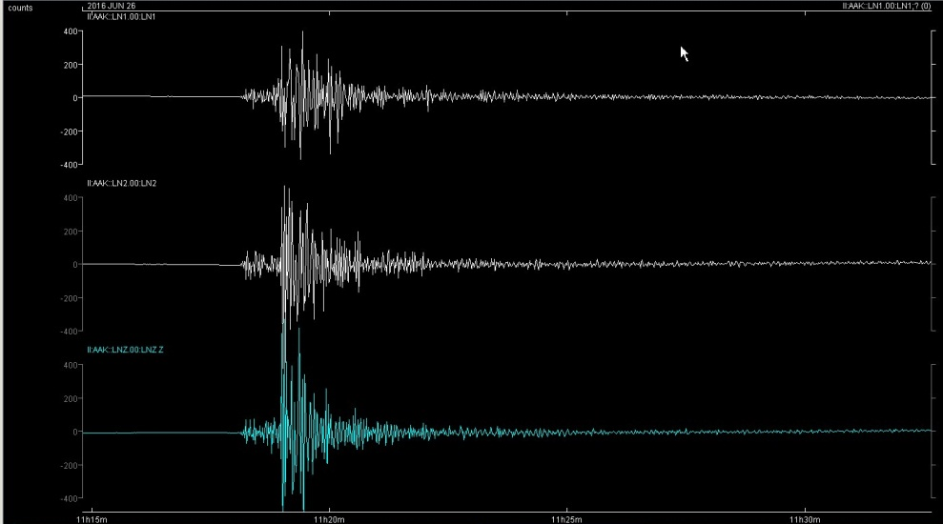
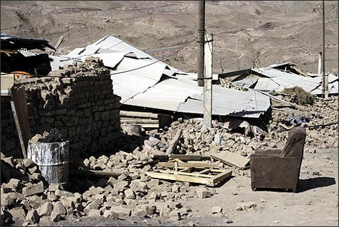
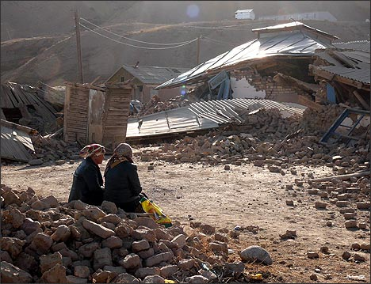
Institute of seismology, National Academy of sciences, Kyrgyz Republic
Examples of strong motion record and earthquake consequence
Nura earthquake (Mw=6.7, 05.10.2008, Kyrgyzstan)
Strong motion record of the Kyzyl-Art earthquake (Mw=6.1, 26.06.2016, Kyrgyzstan)

Slide 10
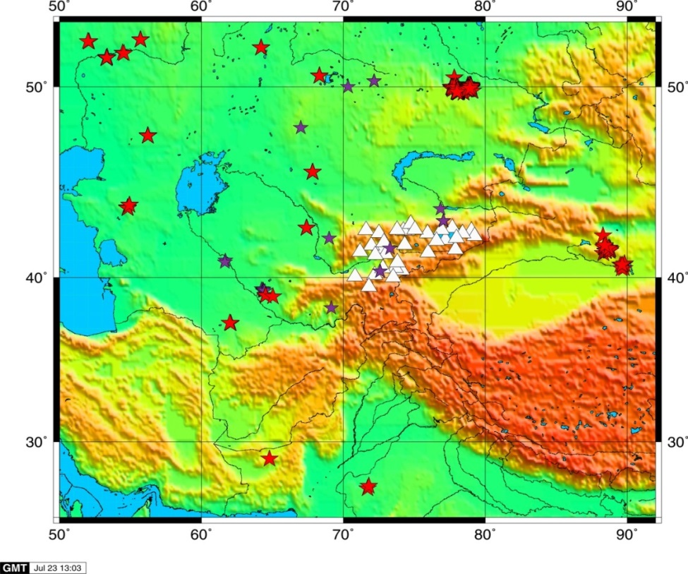
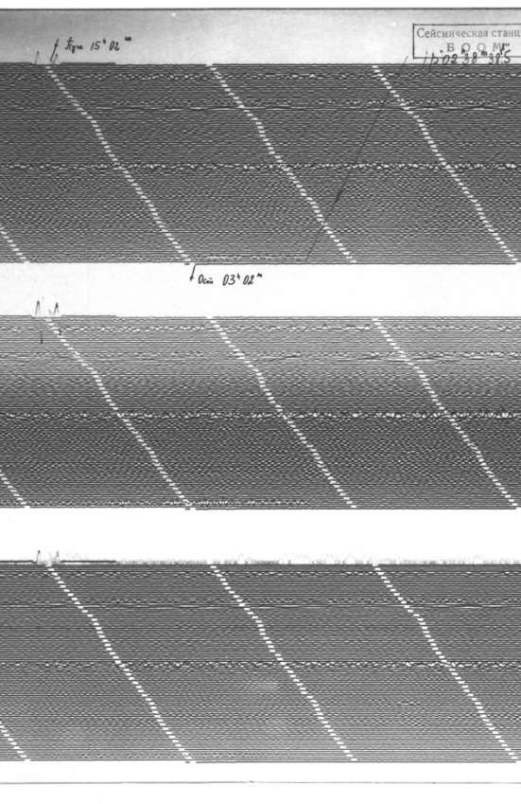
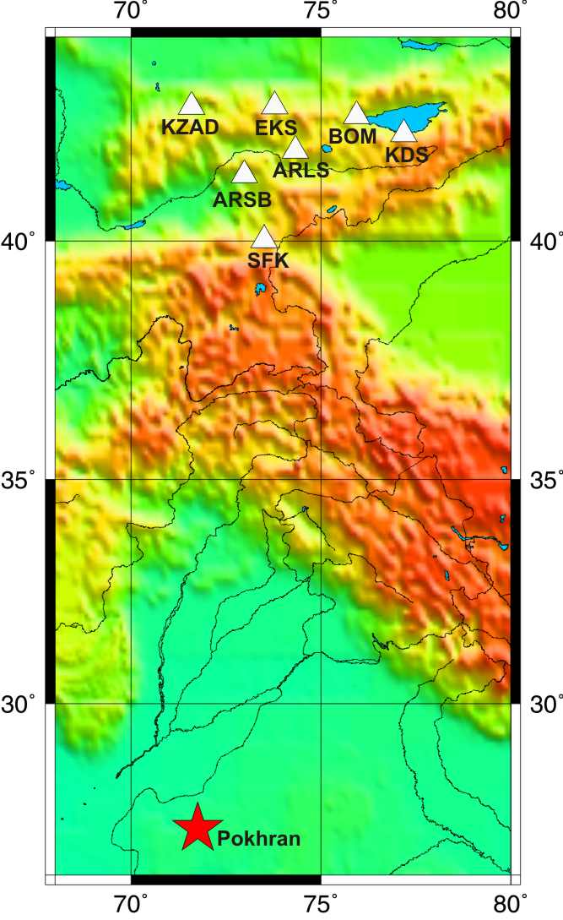
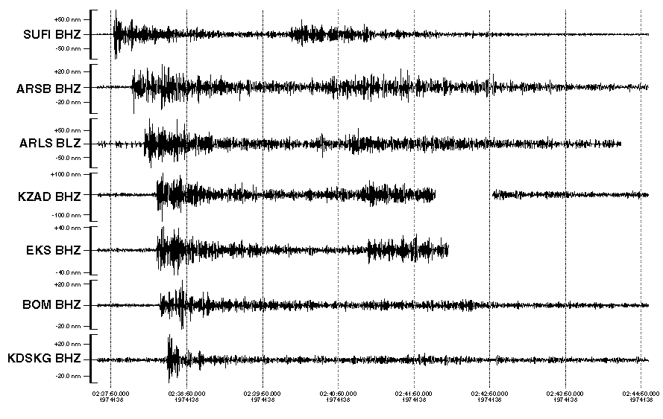
Institute of seismology, National Academy of sciences, Kyrgyz Republic
Monitoring of Explosions
Institute of seismology NAS KR also is responsible for monitoring both of nuclear and chemical explosions. It is necessary to notice that the advantage of Kyrgyzstan’s seismic stations is their location at regional distances according to all Asia nuclear test sites (Semipalatinsk Test Site (Kazakhstan), Lop Nor (China), Pokharan (India), Chagay (Pakistan), Peaceful Nuclear Explosions (PNE) of the former USSR). Besides, most of these stations are located on bedrocks, in tunnels that allowed record even small underground nuclear explosions.
Record of India (Pokharan) nuclear explosion (May, 18, 1974, t0=02-34-55, ϕ=27.095°, λ=71.752°)
Map of location of Kyrgyz system of seismic monitoring (triangles) and epicenters of nuclear (red stars) and strong chemical explosions (violet stars).

Slide 11
Institute of seismology, National Academy of sciences, Kyrgyz Republic
Database of Kyrgyz Institute of seismology
Seismic catalogue since 250 BC till present time. It contains information about more than 165000 earthquakes, occurred on the territory of Kyrgyzstan.
Seismic bulletins since 1950.
Archive of analogue seismograms both of earthquakes and different type of explosions since 1927.
Database of scanned seismograms of nuclear and chemical explosions, part of which has been digitized.
Catalogue of industrial explosions since 1990 till present time.
Archive and database of strong motion records since 1970 till present time.
Catalogue of focal mechanisms since 1946 till present time.
Catalogue of the Kyrgyz active faults.
Different type of catalogues: microshocks, tilt and strain data, geomagneticgeochemical and so on.

Slide 12
Institute of seismology, National Academy of sciences, Kyrgyz Republic
International cooperation
Russia (GS RAS, RS RAS)
UK (ISC, University of Cambridge )
Norway (NORSAR)
CTBTO
USA (IRIS)
Germany (GFZ)
China (Xinjiang Uyghur Autonomous Region Earthquake Administration )
Tajikistan
(IS AS, GS AS)
Kyrgyzstan (Ministry of Emergency Situation )
Kazakhstan
(SEME, IS, KNDC )
Uzbekistan (IS AS)

Slide 13
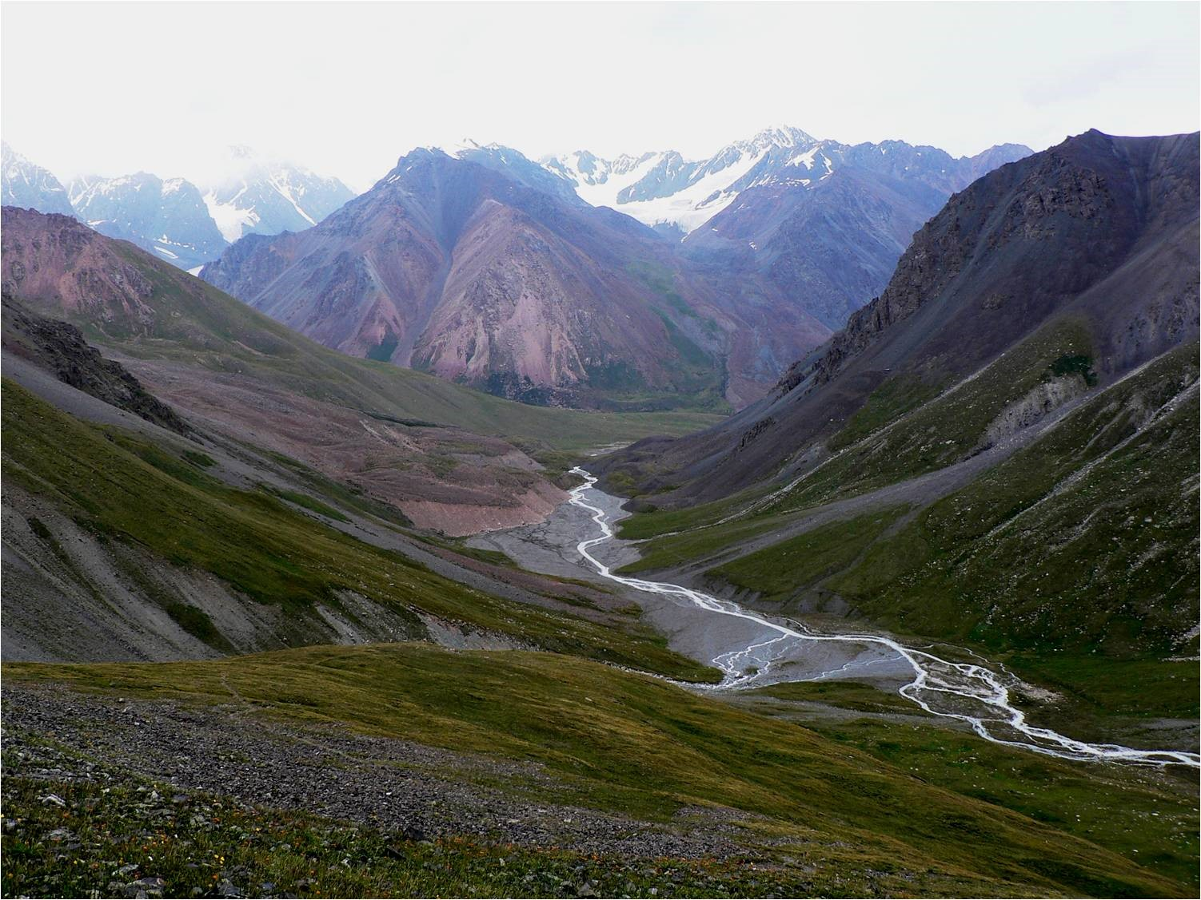
Thank you
for attention!
Thank you
for attention

